Slide 1
Activity
Motor Dynamical Simulation

Slide 2
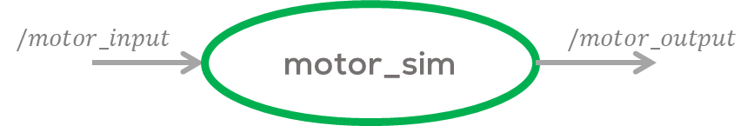
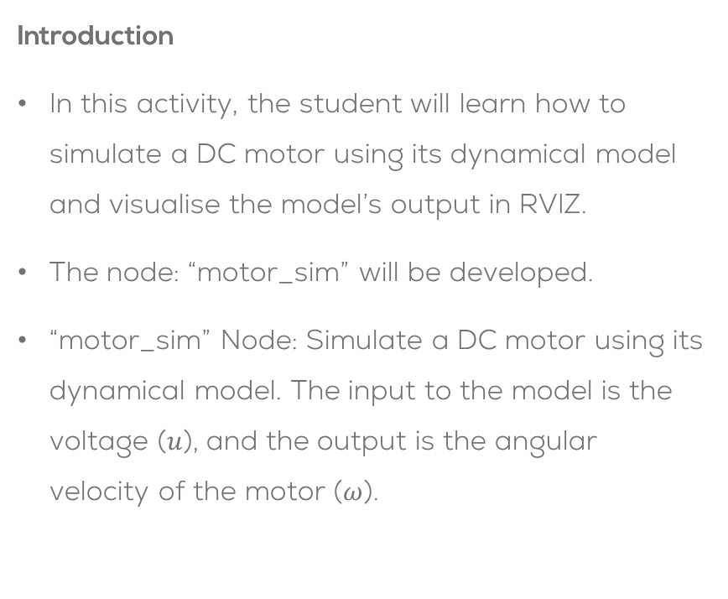
Activity
Introduction
In this activity, the student will learn how to simulate a DC motor using its dynamical model and visualise the model’s output in RVIZ.
The node: “motor_sim” will be developed.
“motor_sim” Node: Simulate a DC motor using its dynamical model. The input to the model is the voltage ($u$), and the output is the angular velocity of the motor ($ω$).

Slide 3
Motor Simulation in RVIZ
Download the package called “motor_sim”, from the folder “/Week4/Activity1/” to your “catkin_ws”
Create a node called “motor_sim.py”” inside the scripts folder
cd ~/catkin_ws/src/motor_sim/scripts/
touch motor_sim.py
Do not forget to give executable permission to the file
cd ~/catkin_ws/src/motor_sim/scripts/
sudo chmod +x motor_sim.py
Modify the CMake file to include the newly created node to the
catkin_install_python(PROGRAMS scripts/motor_sim.py
DESTINATION ${CATKIN_PACKAGE_BIN_DESTINATION})

Slide 4
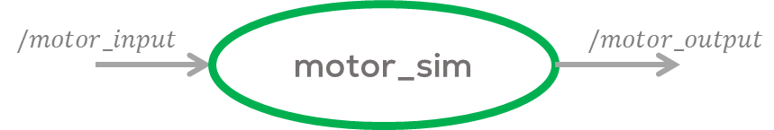
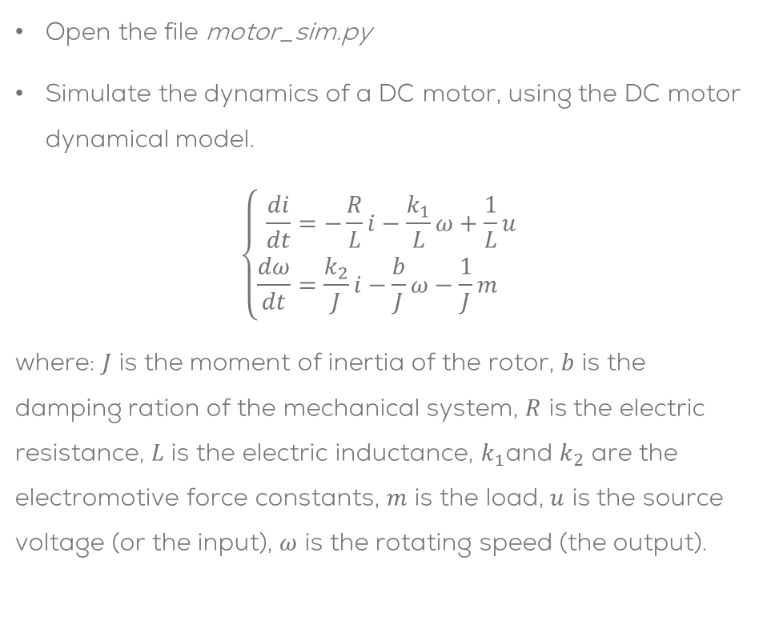
Motor Simulation in RVIZ
Open the file motor_sim.py
Simulate the dynamics of a DC motor, using the DC motor dynamical model.
$$\left\{\begin{aligned}\frac{di}{dt}&=−\frac{R}{L}i−\frac{k_{1}}{L}ω+\frac{1}{L}u \\ \frac{dω}{dt}&=\frac{k_{2}}{J}i−\frac{b}{J}ω−\frac{1}{J}m\end{aligned}\right.$$
where: $J$ is the moment of inertia of the rotor, $b$ is the damping ration of the mechanical system, $R$ is the electric resistance, $L$ is the electric inductance, $k_{1}$and $k_{2}$ are the electromotive force constants, $m$ is the load, $u$ is the source voltage (or the input), $ω$ is the rotating speed (the output).
#Motor Parameters
R = 6.0
L = 0.3
k1 = 0.04
k2 = k1
J = 0.00008
b = 0.00025
m = 0.0
#Motor governing equation
current_dot = -(R/L)*current-(k1/L)*omega+(1/L)*(u)
current += current_dot*dt
omega_dot = (k2/J)*current-(b/J)*omega-(1/J)*m
omega += omega_dot*dt

Slide 5
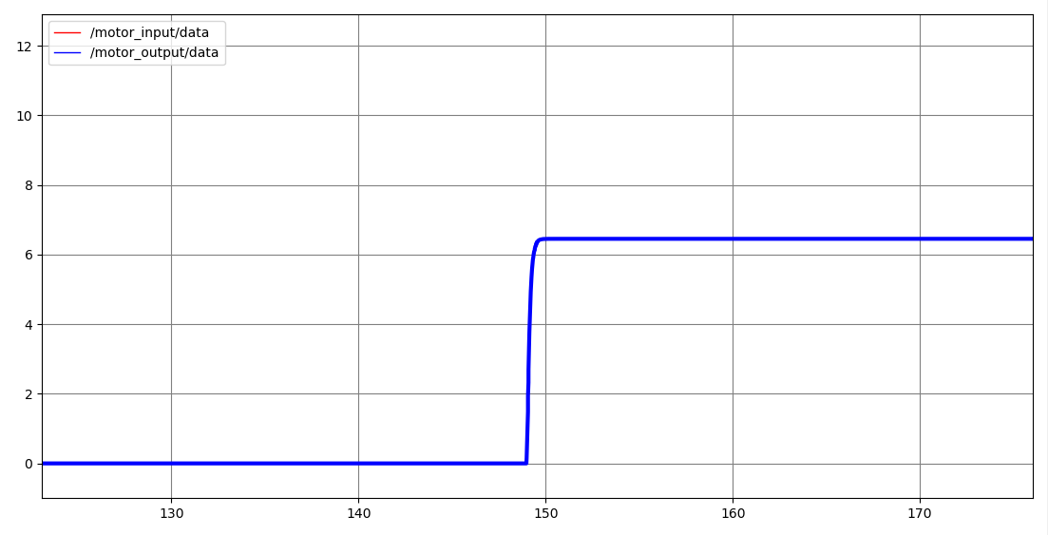

Motor Simulation in RVIZ
Subscribe the model to the topic “/motor_input” and publish the model’s output in the topic “/motor_output”.
Both messages can be Float32 messages.
Make sure to add print some values to verify the program is working properly (debug).
Compile the program
cd ~/catkin_ws
catkin_make
Start ROS
roscore
Run the node
rosrun motor_sim motor_sim.py
Open the rqt_plot to verify the results
Publish a value in the “/motor_input” topic in the range of $u=[−1,1]$.
rostopic pub /motor_input std_msgs/Float32 "data: 0.3"
Verify the results

Slide 6
Activity
Part 2: Visualisation

Slide 7
Motor Simulation in RVIZ
Use the “motor_JointPub.py” to publish the data to the joints of the model.
Add the newly created node “motor_sim.py” to the launch file “motor_sim.launch”.
<?xml version="1.0"?>
<launch>
<!-- Load URDF-->
<arg name="motor_urdf" default="$(find links_act)/urdf/dc_motor.urdf"/>
<!--Set URDF file as a robot_description parameter-->
<param name="robot_description" command="cat $(arg motor_urdf)" />
<!--Initialise robot_state_publisher-->
<node pkg="robot_state_publisher" type="robot_state_publisher" name="motor_urdf_pub" >
</node>
<!--Initialise motor joint publisher-->
<node pkg="motor_sim" type="motor_JointPub.py" name="motor_JointPub" />
<!--Initialise motor dynamical simulation-->
<node pkg="motor_sim" type="motor_sim.py" name="motor_Sim" />
</launch>

Slide 8
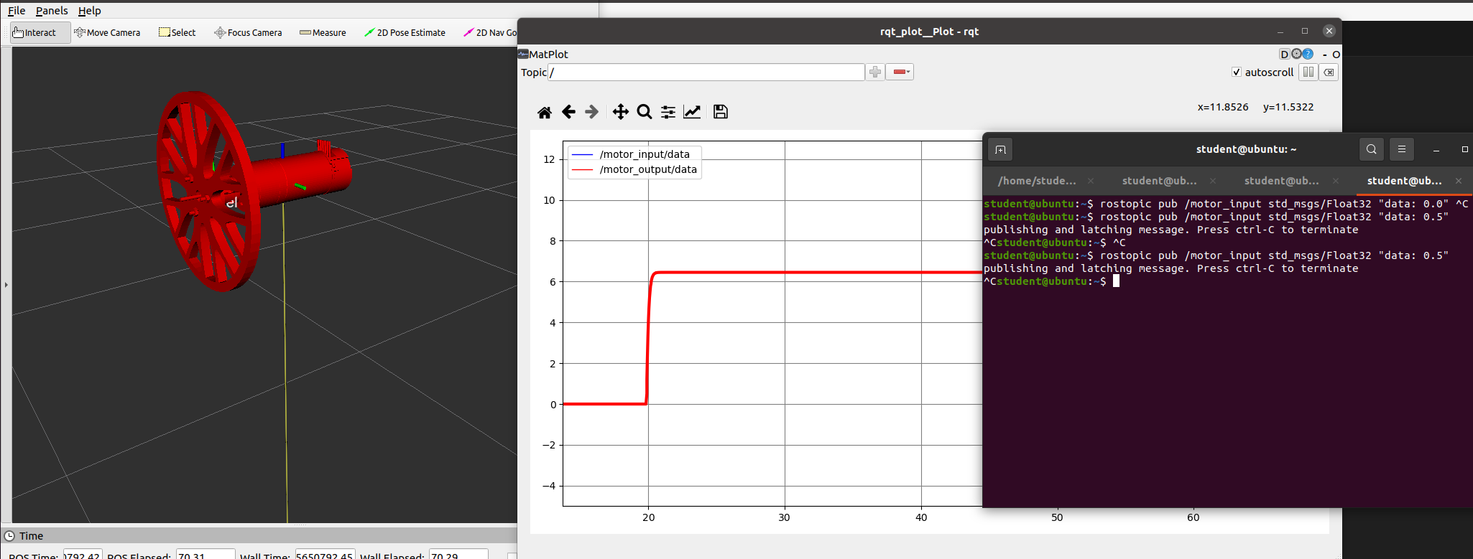
Motor Simulation in RVIZ

